Slide 1
On the Key Problems of GANs
Speaker: Zhiming Zhou
Notes:
此页可以删除

Slide 2
About Me
Education:
Ph.D. candidate in Computer Science, Shanghai Jiao Tong University.
Bachelor’s degree obtained from ACM class, Shanghai Jiao Tong University.
Research Interest:
Currently mainly focus on GANs. (2017 ~ now)
Also work on related problems, including optimization, optimal transport, etc.
Used to work on Computer Graphics. (2014 ~ 2016)
Surface reflectance acquisition, related to sparsity, low-rank, and deblurring.
Plan to extend and gradually move to Deep Learning Theory.

Slide 3
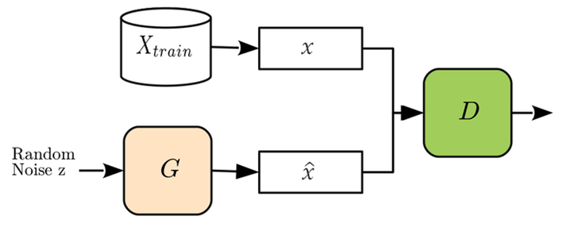
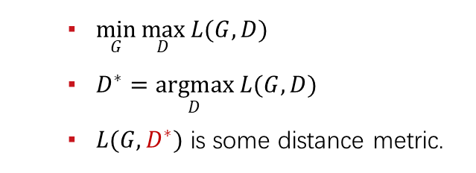
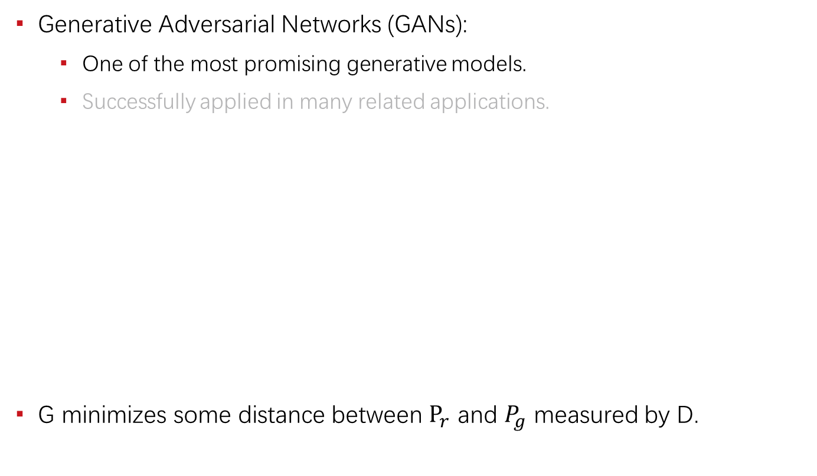
Introduction
Generative Adversarial Networks (GANs):
One of the most promising generative models.
Successfully applied in many related applications.
G minimizes some distance between $P_{r}$ and $P_{g}$ measured by D.
$\min_{G}{\max_{D}{L(G, D)}}$
$D^{∗}=\underset{D}{argmax}{L(G, D)}$
$L(G, D^{∗})$ is some distance metric.

Slide 4
Key Problems
Training issues
Instability
Unreachable optimum
Sample quality issues
Complex dataset
Ghost effect
Generalization issue
Symptoms:
Hyperparameter sensitive
Mode collapse
Training failure (diverge / crash)
Related work:
Lipschitz GANs. (ICML, 2019)

Slide 5
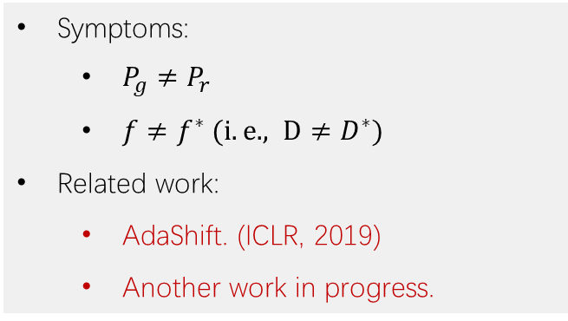
Key Problems
Training issues
Instability
Unreachable optimum
Sample quality issues
Complex dataset
Ghost effect
Generalization issue
Symptoms:
$P_{g}≠P_{r}$
$f≠f^{∗} (i.e. , D≠D^{∗})$
Related work:
AdaShift. (ICLR, 2019)
Another work in progress.

Slide 6
Key Problems
Training issues
Instability
Unreachable optimum
Sample quality issues
Complex dataset
Ghost effect
Generalization issue
Symptoms:
High quality on simple dataset.
Hard to model complex dataset.
Related work:
AM-GAN. (ICLR, 2018)

Slide 7
Key Problems
Training issues
Instability
Unreachable optimum
Sample quality issues
Complex dataset
Ghost effect
Generalization issue
Symptoms:
Unavoidable low quality samples.
(Even if it is generally high quality.)
Interpolate between different classes.
Related work:
Some preliminary results.
Latent space optimization:
Homologous topology.
Auto-clustering. (Multi-Angle)
Representation learning.
Provable Local optimum.

Slide 8
Key Problems
Training issues
Instability
Unreachable optimum
Sample quality issues
Complex dataset
Ghost effect
Generalization issue
Symptoms:
When it reaches the optimum,
Perfectly memorize the dataset.
Related work:
Work in progress.

Slide 9
Training Instability
Mainly from Lipschitz GANs. (ICML, 2019)

Slide 10
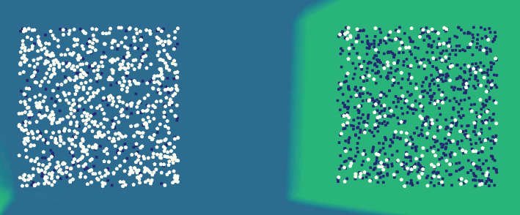
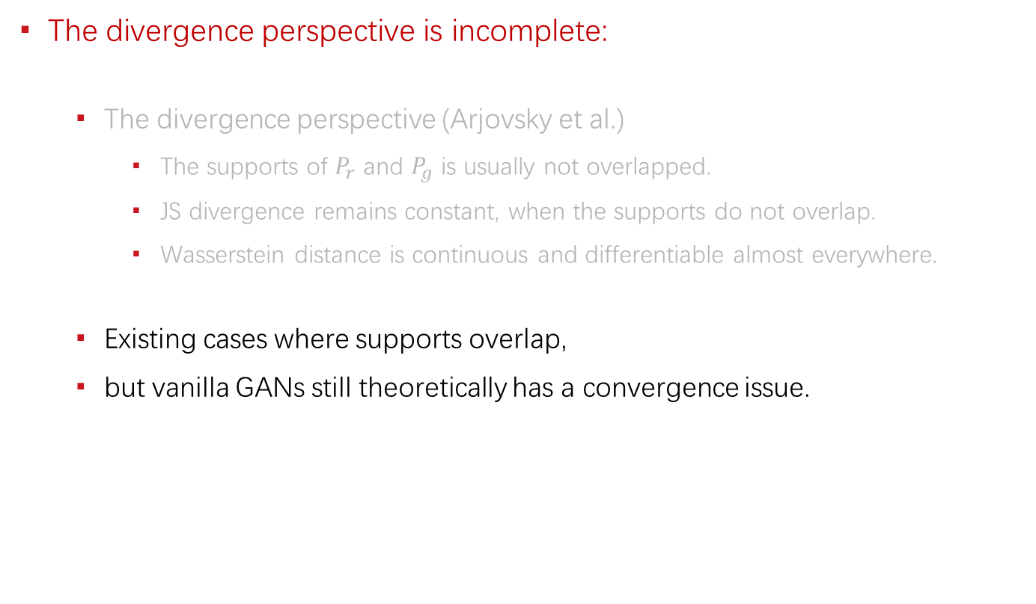
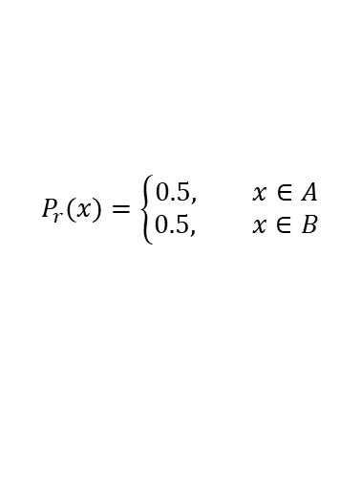
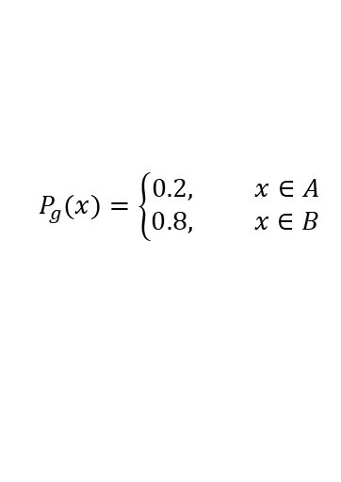
The Essence of Convergence
The divergence perspective is incomplete:
The divergence perspective (Arjovsky et al.)
The supports of $P_{r}$ and $P_{g}$ is usually not overlapped.
JS divergence remains constant, when the supports do not overlap.
Wasserstein distance is continuous and differentiable almost everywhere.
Existing cases where supports overlap,
but vanilla GANs still theoretically has a convergence issue.
$$P_{g}(x)=\left\{\begin{aligned}0.2, x∈A \\ 0.8, x∈B\end{aligned}\right.$$
$$P_{r}(x)=\left\{\begin{aligned}0.5, x∈A \\ 0.5, x∈B\end{aligned}\right.$$

Slide 11
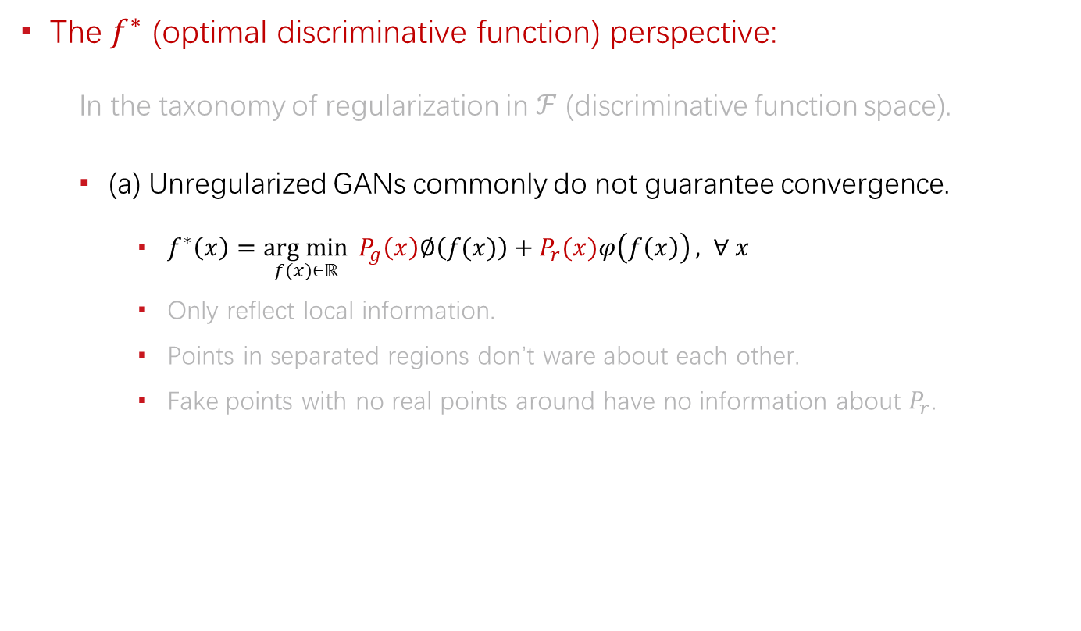
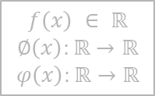
The Essence of Convergence
The $f^{∗}$ (optimal discriminative function) perspective:
In the taxonomy of regularization in $ℱ$ (discriminative function space).
(a) Unregularized GANs commonly do not guarantee convergence.
$f^{∗}\left(x\right)=\underset{f(x)∈ℝ}{arg min}{ P_{g}\left(x\right)∅\left(f(x)\right)+P_{r}(x)φ\left(f\left(x\right)\right)}, ∀ x$
Only reflect local information.
Points in separated regions don’t ware about each other.
Fake points with no real points around have no information about $P_{r}$.
$$f\left(x\right) ∈ ℝ$$
$$∅\left(x\right):ℝ→ℝ$$
$$φ\left(x\right):ℝ→ℝ$$
$$P_{g}(x)=\left\{\begin{aligned}0.2, x∈A \\ 0.8, x∈B\end{aligned}\right.$$
$$P_{r}(x)=\left\{\begin{aligned}0.5, x∈A \\ 0.5, x∈B\end{aligned}\right.$$
Including vanilla GAN, Least-squares GAN, f-GAN, etc.

Slide 12
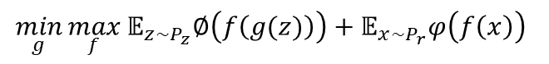
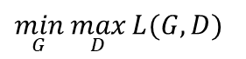
Generalized Formulation of GANs
$$\min_{G}{\max_{D}{L(G, D)}}$$
$$\min_{g}{\max_{f}}𝔼_{z\sim P_{z}}∅\left(f\left(g(z)\right)\right)+𝔼_{x\sim P_{r}}φ\left(f\left(x\right)\right)$$
$f$ is another notation for $D$ and $f^{∗}$ is the optimal $f$.

Slide 13
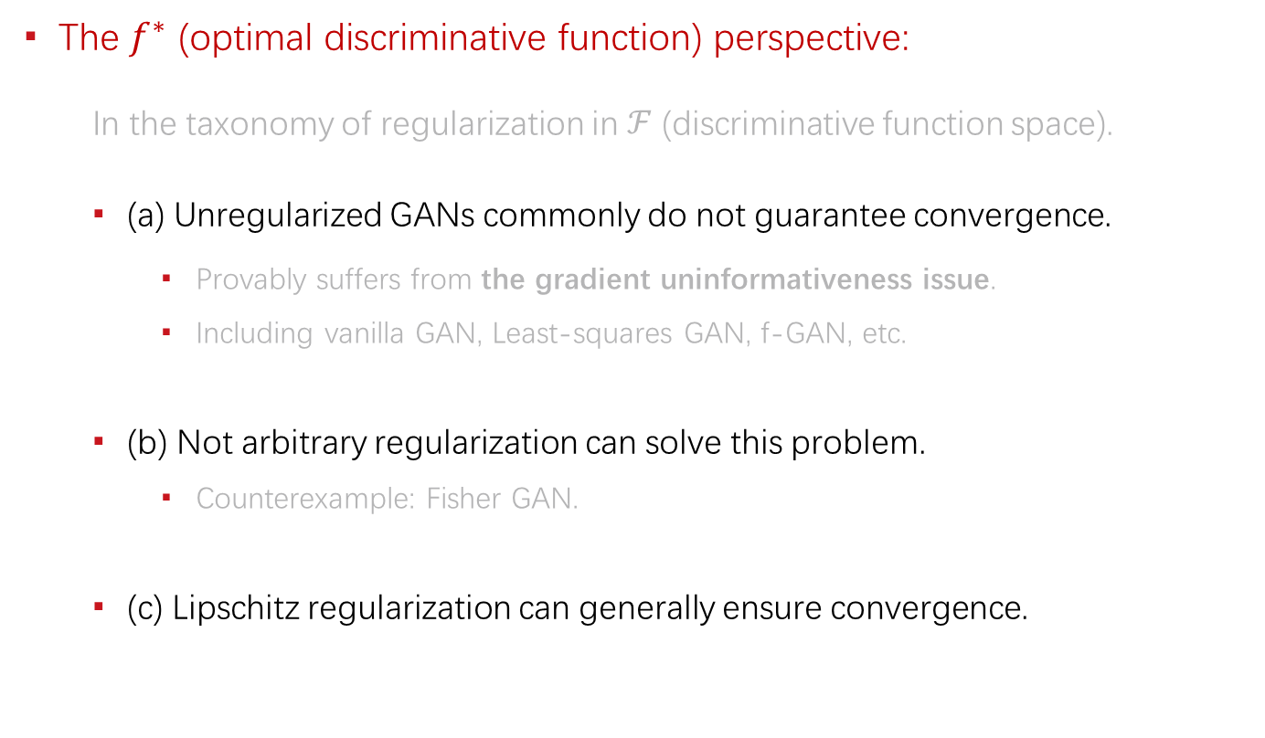
The Essence of Convergence
The $f^{∗}$ (optimal discriminative function) perspective:
In the taxonomy of regularization in $ℱ$ (discriminative function space).
(a) Unregularized GANs commonly do not guarantee convergence.
Provably suffers from the gradient uninformativeness issue.
Including vanilla GAN, Least-squares GAN, f-GAN, etc.
(b) Not arbitrary regularization can solve this problem.
Counterexample: Fisher GAN.
(c) Lipschitz regularization can generally ensure convergence.

Slide 14
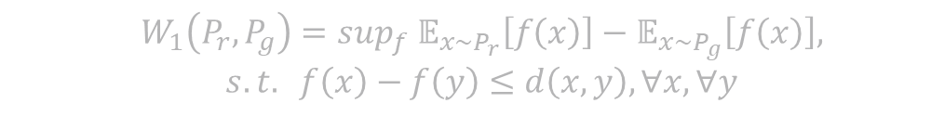
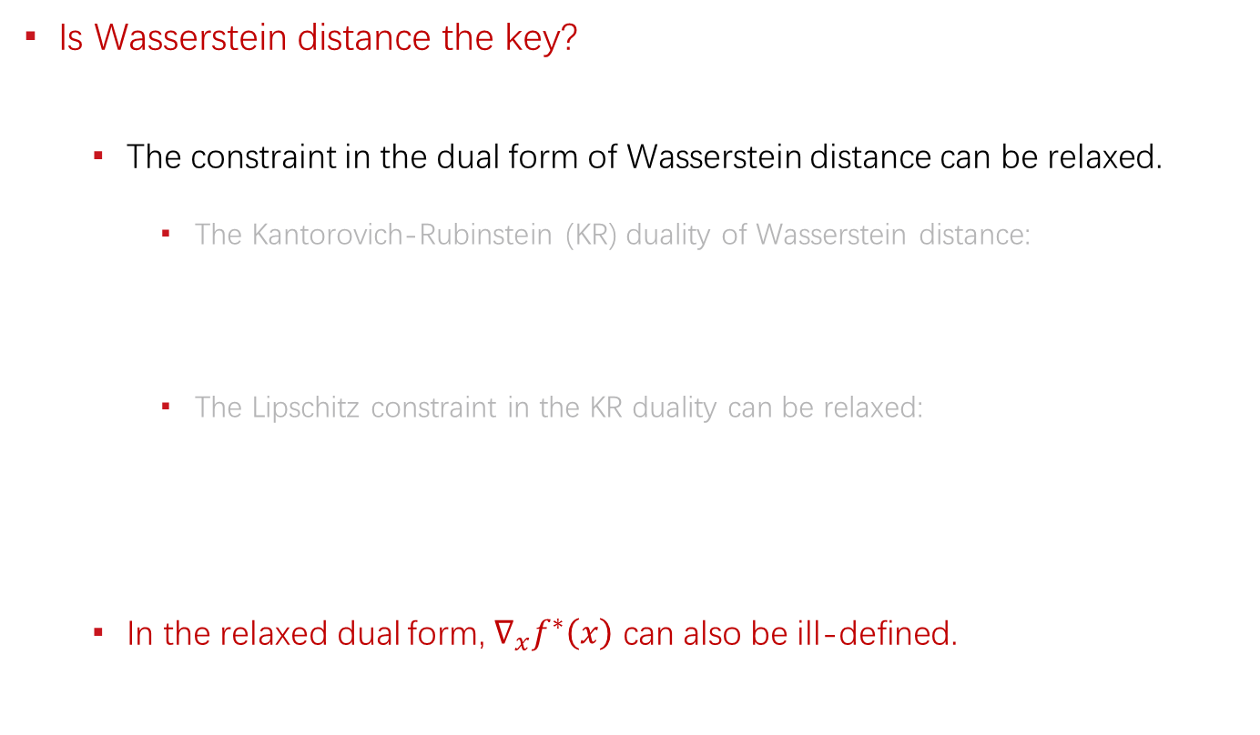

The Essence of Convergence
Is Wasserstein distance the key?
The constraint in the dual form of Wasserstein distance can be relaxed.
The Kantorovich-Rubinstein (KR) duality of Wasserstein distance:
The Lipschitz constraint in the KR duality can be relaxed:
In the relaxed dual form, $∇_{x}f^{∗}\left(x\right)$ can also be ill-defined.
$$W_{1}\left(P_{r}, P_{g}\right)=\sup_{f} 𝔼_{x\sim P_{r}}\left[f\left(x\right)\right]−𝔼_{x\sim P_{g}}\left[f\left(x\right)\right],$$
$$s.t. f\left(x\right)−f\left(y\right)≤d\left(x,y\right), ∀x, ∀y$$
$$W_{1}\left(P_{r}, P_{g}\right)=\sup_{f} 𝔼_{x\sim P_{r}}\left[f\left(x\right)\right]−𝔼_{x\sim P_{g}}\left[f\left(x\right)\right],$$
$$s.t. f\left(x\right)−f\left(y\right)≤d\left(x,y\right), ∀x∈supp(P_{r},) ∀y∈supp(P_{g})$$

Slide 15
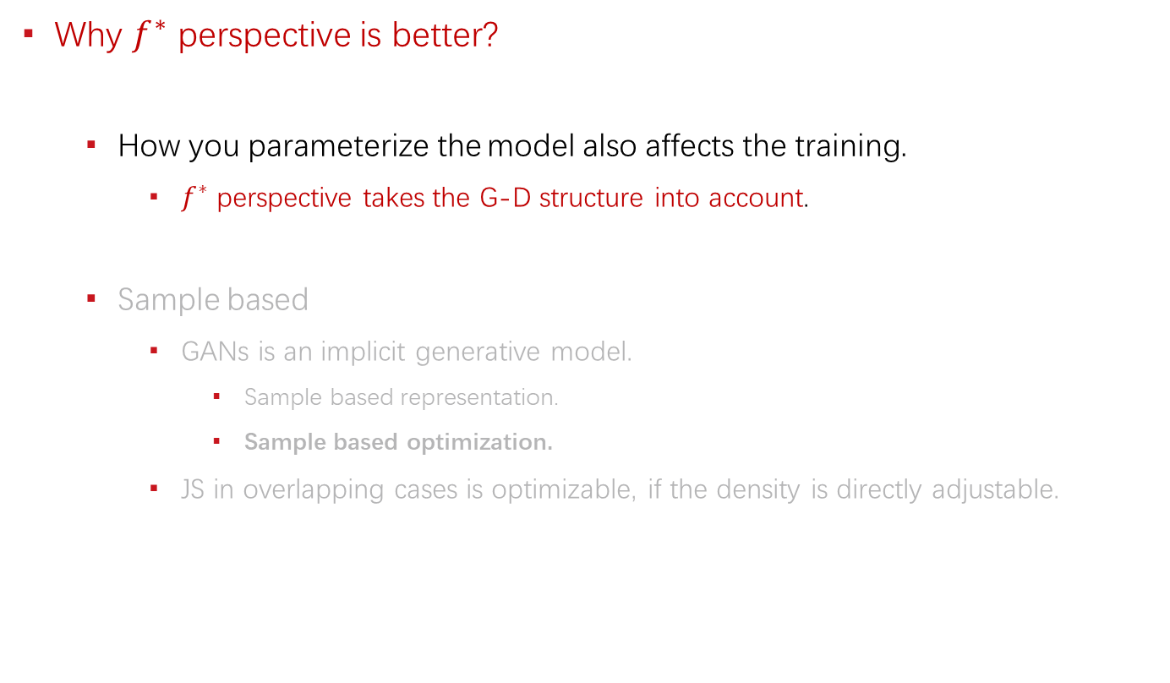
The Essence of Convergence
Why $f^{∗}$ perspective is better?
How you parameterize the model also affects the training.
$f^{∗}$ perspective takes the G-D structure into account.
Sample based
GANs is an implicit generative model.
Sample based representation.
Sample based optimization.
JS in overlapping cases is optimizable, if the density is directly adjustable.

Slide 16
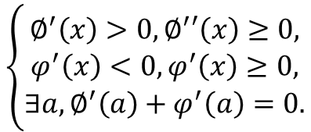
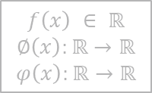
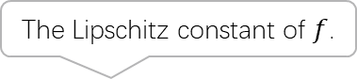
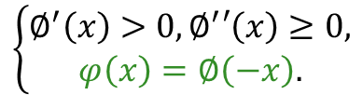
Lipschitz GANs
General formulation:
As long as, it satisfies:
Any increasing function with no decreasing derivative derives a LGAN.
The Lipschitz constant of $f$.
$$𝔼_{z\sim P_{z}}∅\left(f\left(g(z)\right)\right)+𝔼_{x\sim P_{r}}φ\left(f\left(x\right)\right)+λ∙{k(f)}^{2}$$
$$f\left(x\right) ∈ ℝ$$
$$∅\left(x\right):ℝ→ℝ$$
$$φ\left(x\right):ℝ→ℝ$$
The generalized formulation of GANs.
$$\left\{\begin{aligned}∅^{′}\left(x\right)>0,∅^{′}′\left(x\right)≥0, \\ φ^{′}\left(x\right)<0,φ^{′}\left(x\right)≥0, \\ ∃a,∅^{′}\left(a\right)+φ^{′}\left(a\right)=0.\end{aligned}\right.$$
or simplified as:
(more restrictive)
$$\left\{\begin{aligned}∅^{′}\left(x\right)>0,∅^{′}′\left(x\right)≥0, \\ φ\left(x\right)=∅\left(−x\right).\end{aligned}\right.$$

Slide 17
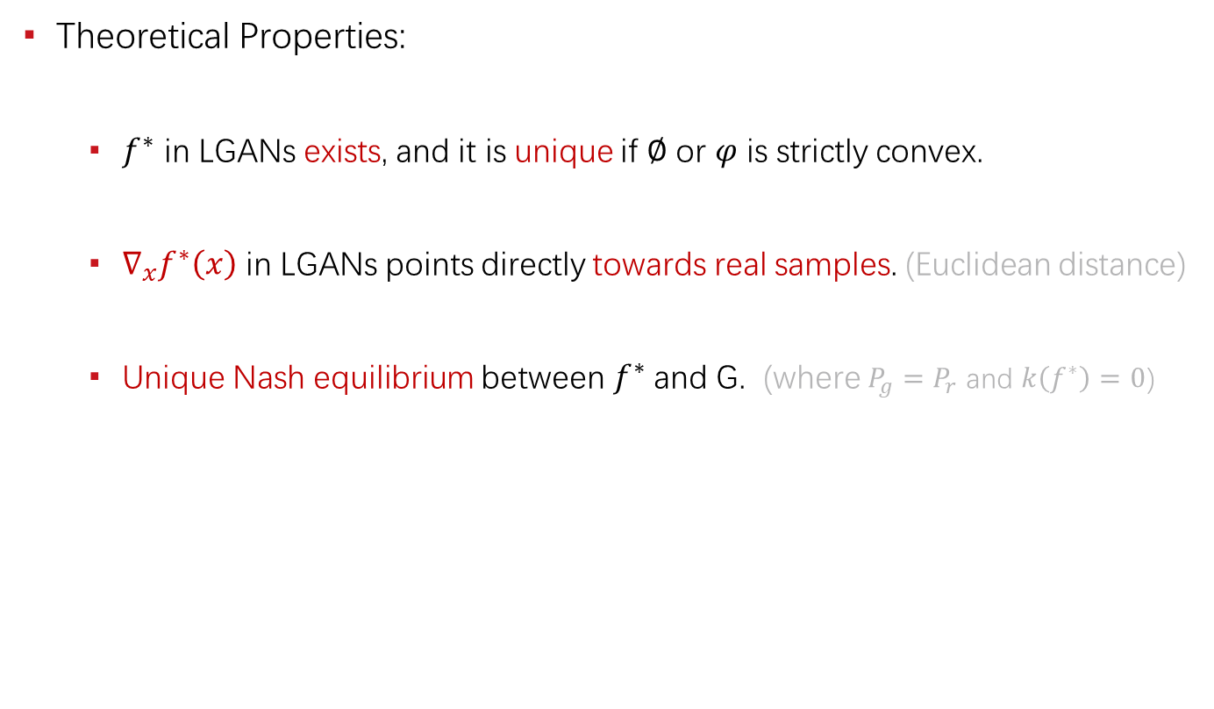
Lipschitz GANs
Theoretical Properties:
$f^{∗}$ in LGANs exists, and it is unique if $∅$ or $φ$ is strictly convex.
$∇_{x}f^{∗}\left(x\right)$ in LGANs points directly towards real samples. (Euclidean distance)
Unique Nash equilibrium between $f^{∗}$ and G. (where $P_{g}=P_{r}$ and $k\left(f^{∗}\right)=0$)

Slide 18
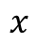
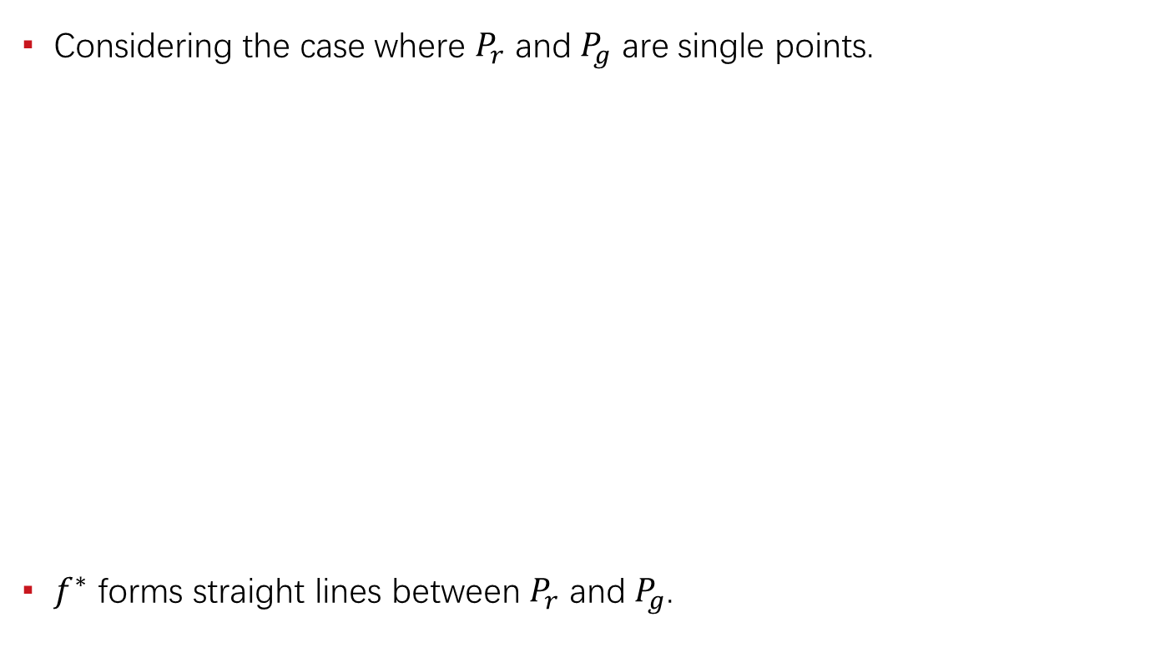
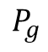
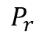
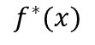
Illustration
Considering the case where $P_{r}$ and $P_{g}$ are single points.
$f^{∗}$ forms straight lines between $P_{r}$ and $P_{g}$.
$$f^{∗}(x)$$
The line in between is well defined, while others are not.
$$P_{r}$$
$$P_{g}$$
$$x$$

Slide 19
Experiments
Practical behaviors of gradient uninformativeness: (noise)

Slide 20
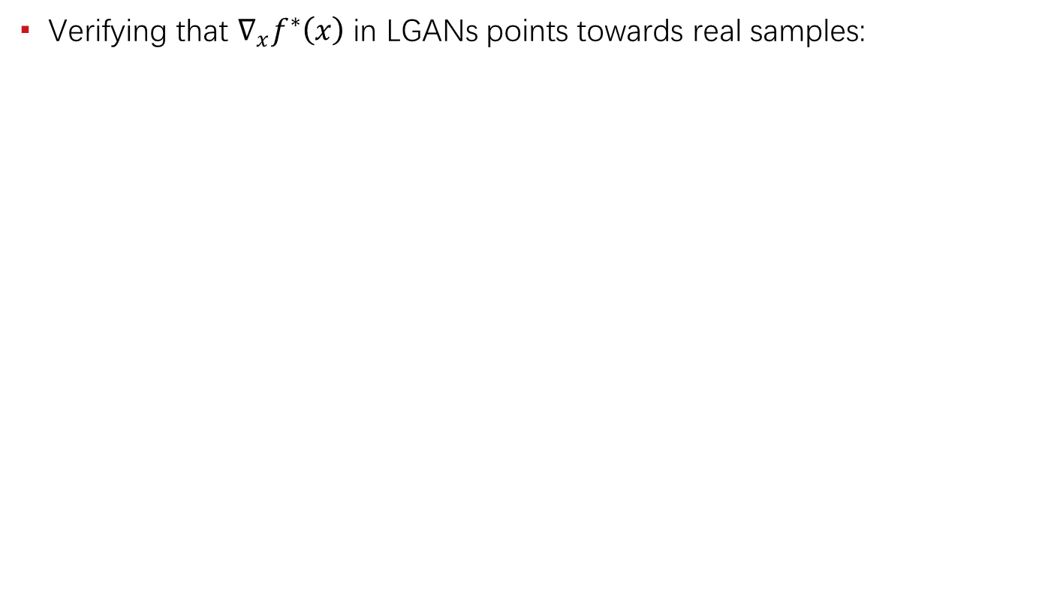
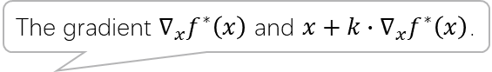
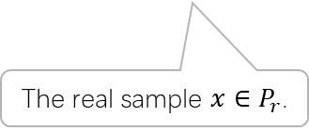
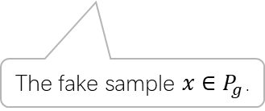
Experiments
Verifying that $∇_{x}f^{∗}\left(x\right)$ in LGANs points towards real samples:
The gradient $∇_{x}f^{∗}\left(x\right)$ and $x+k∙∇_{x}f^{∗}\left(x\right)$.
The fake sample $x∈P_{g}$.
The real sample $x∈P_{r}$.

Slide 21

Experiments
The influence of uniqueness of $f^{∗}$: (stabilized)

Slide 22
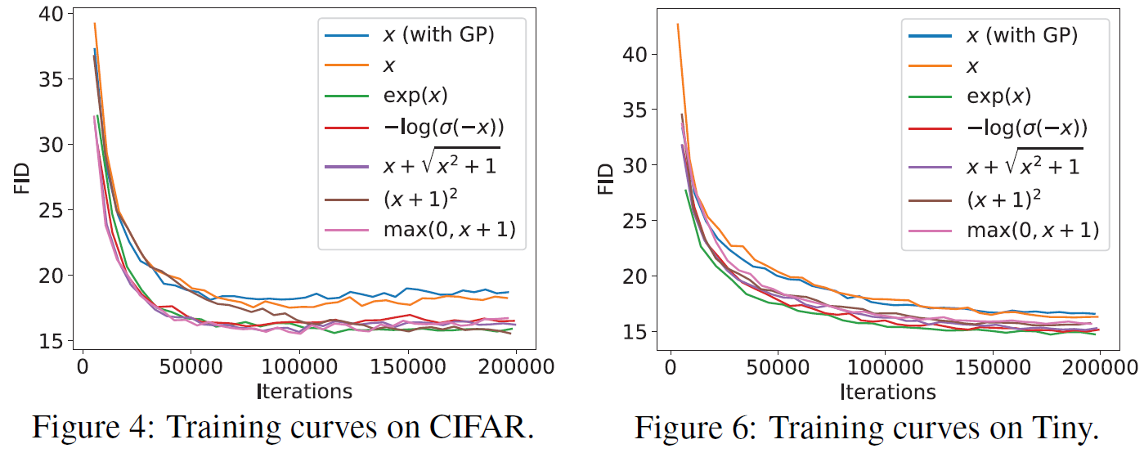
Experiments
Benchmark the LGANs family: (consistently outperform WGAN)

Slide 23
Experiments
Benchmark the LGANs family: (consistently outperform WGAN)

Slide 24

Mode Collapse
Objective level cause: (main)
Unrestricted GANs (including vanilla GAN)
Existence of gathering / clustering effect. (local greedy)
Missing of force to separate clustered samples.
Existence of local optimum.
WGAN / LGANs
No objective level local optimum.
Existence of force to separate clustered samples. (if not clustered to a single point)
Neural network level cause: (minor)
Network degeneration. (related to training failure)
Limited capacity / expressiveness issue.
A local optimum state of some traditional GANs.

Slide 25
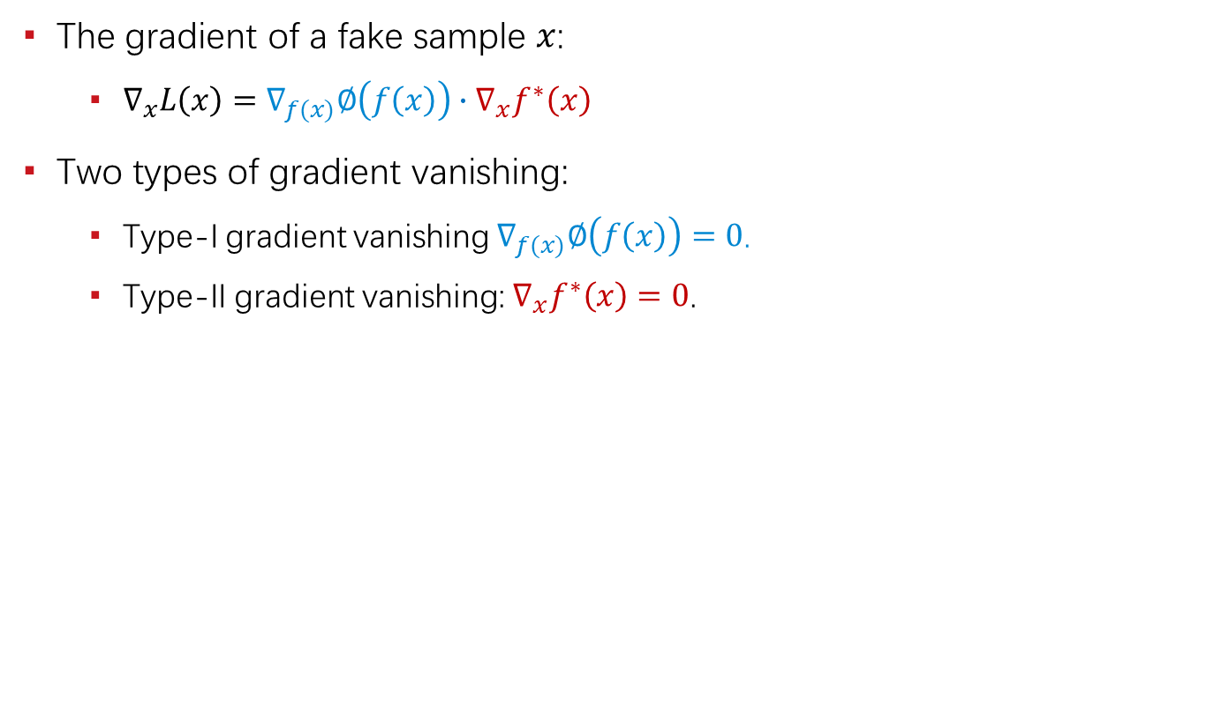
Gradient Vanishing
The gradient of a fake sample $x$:
$∇_{x}L\left(x\right)=∇_{f(x)}∅\left(f\left(x\right)\right)∙∇_{x}f^{∗}\left(x\right)$
Two types of gradient vanishing:
Type-I gradient vanishing $∇_{f(x)}∅\left(f\left(x\right)\right)=0$.
Type-II gradient vanishing: $∇_{x}f^{∗}\left(x\right)=0$.
 | Type-I Gradient Vanishing | Type-II Gradient Vanishing
Vanilla GAN | Yes | Yes
Least-squares GAN | No | Yes
WGAN / LGANs | No | No

Slide 26
Unreachable Optimum
Evidences & Possible Causes

Slide 27
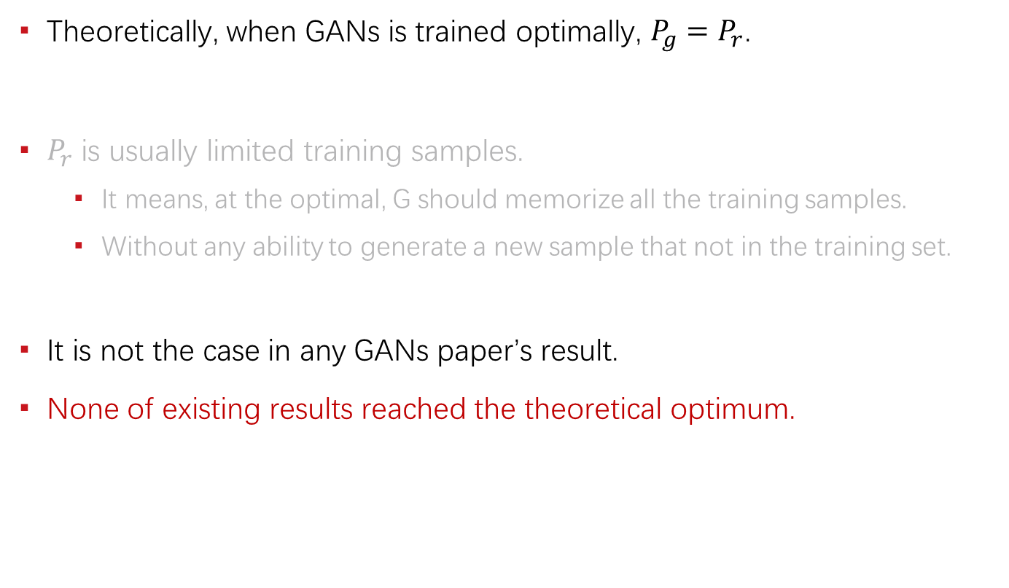
The Evidences
Theoretically, when GANs is trained optimally, $P_{g}=P_{r}$.
$P_{r}$ is usually limited training samples.
It means, at the optimal, G should memorize all the training samples.
Without any ability to generate a new sample that not in the training set.
It is not the case in any GANs paper’s result.
None of existing results reached the theoretical optimum.

Slide 28
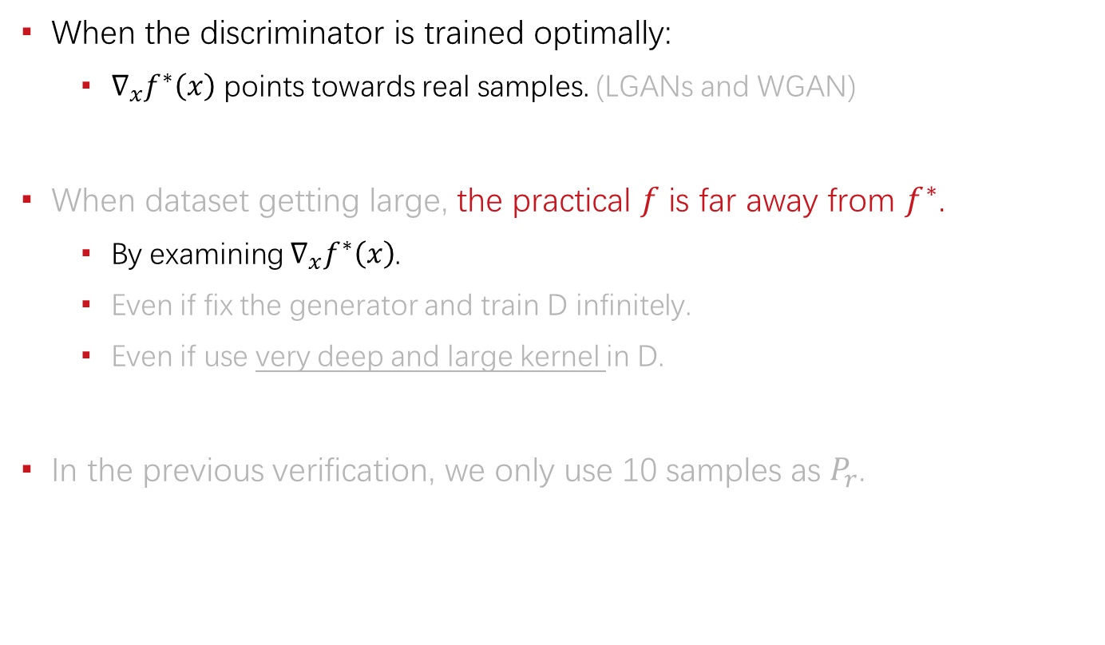
The Evidences
When the discriminator is trained optimally:
$∇_{x}f^{∗}\left(x\right)$ points towards real samples. (LGANs and WGAN)
When dataset getting large, the practical $f$ is far away from $f^{∗}$.
By examining $∇_{x}f^{∗}\left(x\right)$.
Even if fix the generator and train D infinitely.
Even if use very deep and large kernel in D.
In the previous verification, we only use 10 samples as $P_{r}$.

Slide 29
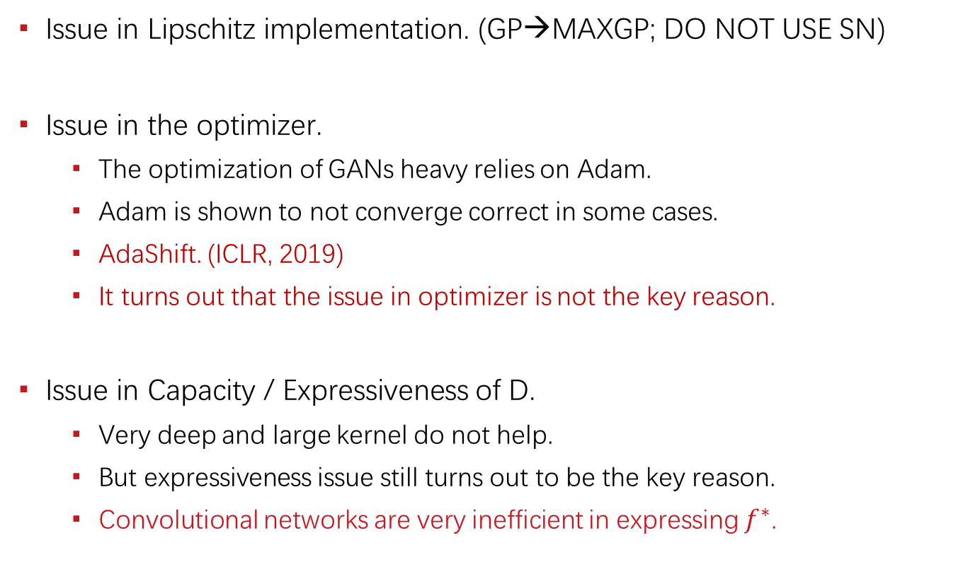
Possible Causes
Issue in Lipschitz implementation. (GP→MAXGP; DO NOT USE SN)
Issue in the optimizer.
The optimization of GANs heavy relies on Adam.
Adam is shown to not converge correct in some cases.
AdaShift. (ICLR, 2019)
It turns out that the issue in optimizer is not the key reason.
Issue in Capacity / Expressiveness of D.
Very deep and large kernel do not help.
But expressiveness issue still turns out to be the key reason.
Convolutional networks are very inefficient in expressing $f^{∗}$.

Slide 30
The Convergence of Adam
Mainly from Adashift. (ICLR, 2019)

Slide 31
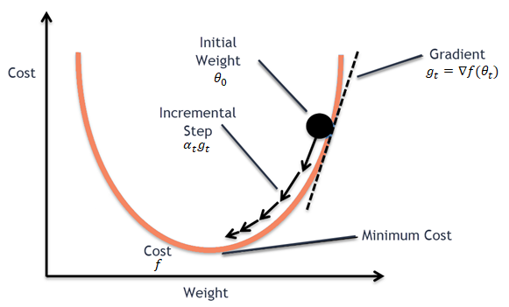
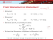
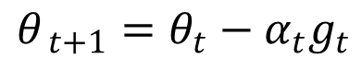
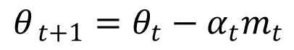
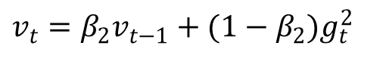
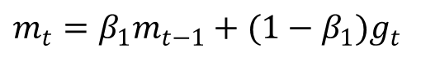
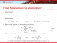
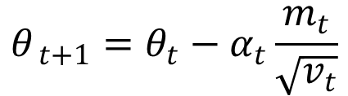
SGD → Adam
SGD:
Momentum*:
Adam:
$$θ_{ t+1}=θ_{t}−α_{t}g_{t}$$
$$θ_{ t+1}=θ_{t}−α_{t}m_{t}$$
$$m_{t}=β_{1}m_{t−1}+(1−β_{1})g_{t}$$
$$θ_{ t+1}=θ_{t}−α_{t}\frac{m_{t}}{\sqrt{v_{t}}}$$
$$v_{t}=β_{2}v_{t−1}+(1−β_{2})g_{t}^{2}$$

Slide 32
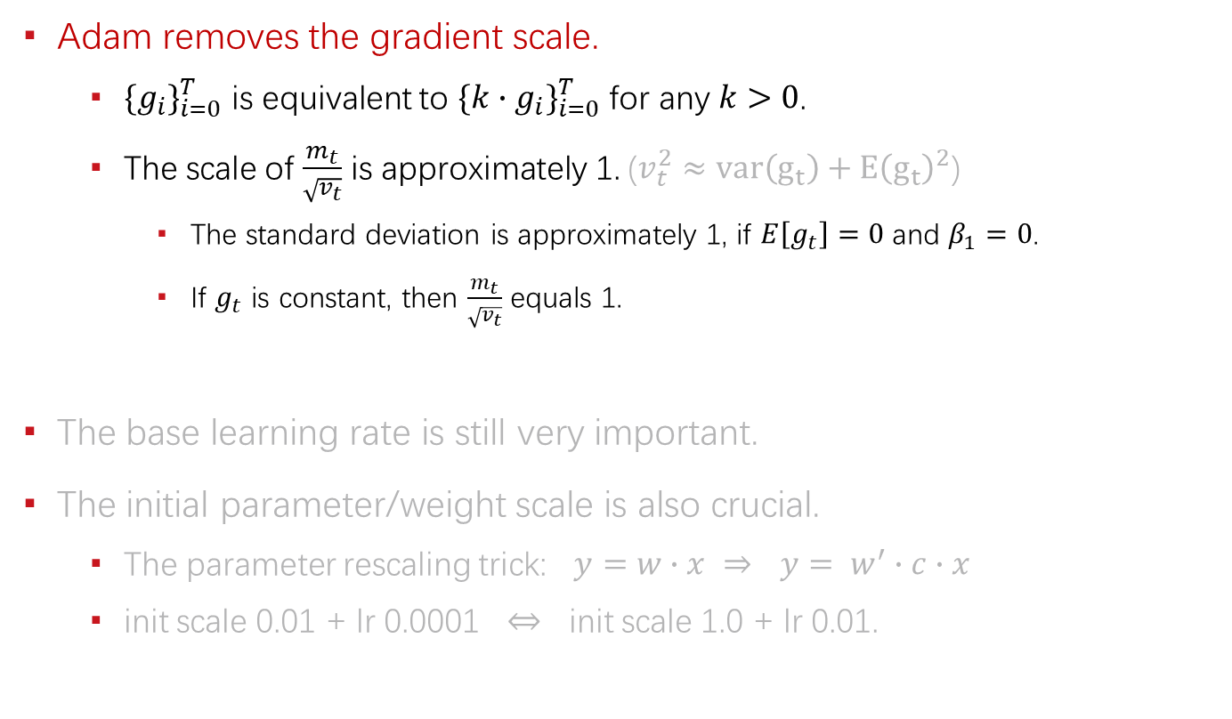
Adam’s properties
Adam removes the gradient scale.
${\{g_{i}\}}_{i=0}^{T}$ is equivalent to ${\{k∙g_{i}\}}_{i=0}^{T}$ for any $k>0$.
The scale of $\frac{m_{t}}{\sqrt{v_{t}}}$ is approximately 1. ($v_{t}^{2}≈var\left(g_{t}\right)+Ε{\left(g_{t}\right)}^{2}$)
The standard deviation is approximately 1, if $E\left[g_{t}\right]=0$ and $β_{1}=0$.
If $g_{t}$ is constant, then $\frac{m_{t}}{\sqrt{v_{t}}}$ equals 1.
The base learning rate is still very important.
The initial parameter/weight scale is also crucial.
The parameter rescaling trick: $y=w∙x$ $⇒$ $y= w^{′}∙c∙x$
init scale 0.01 + lr 0.0001 $⇔$ init scale 1.0 + lr 0.01.

Slide 33
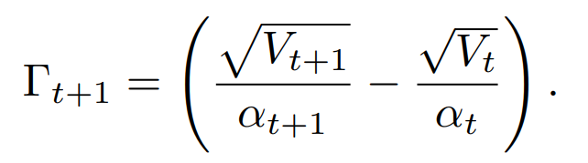
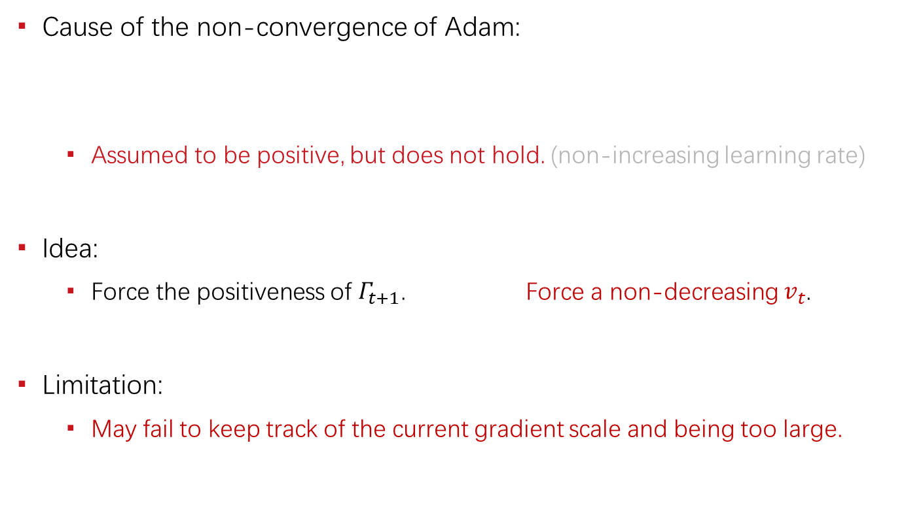
Existing Solution: AMSGrad
Cause of the non-convergence of Adam:
Assumed to be positive, but does not hold. (non-increasing learning rate)
Idea:
Force the positiveness of $Γ_{t+1}$. Force a non-decreasing $v_{t}$.
Limitation:
May fail to keep track of the current gradient scale and being too large.

Slide 34
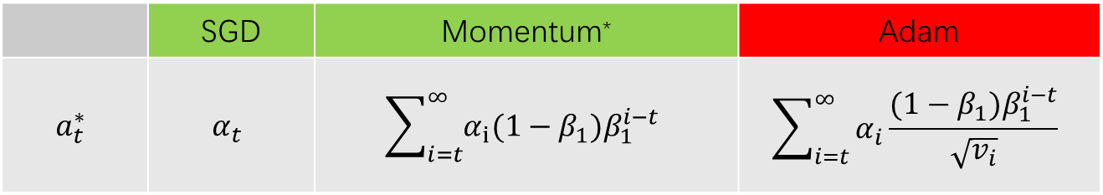
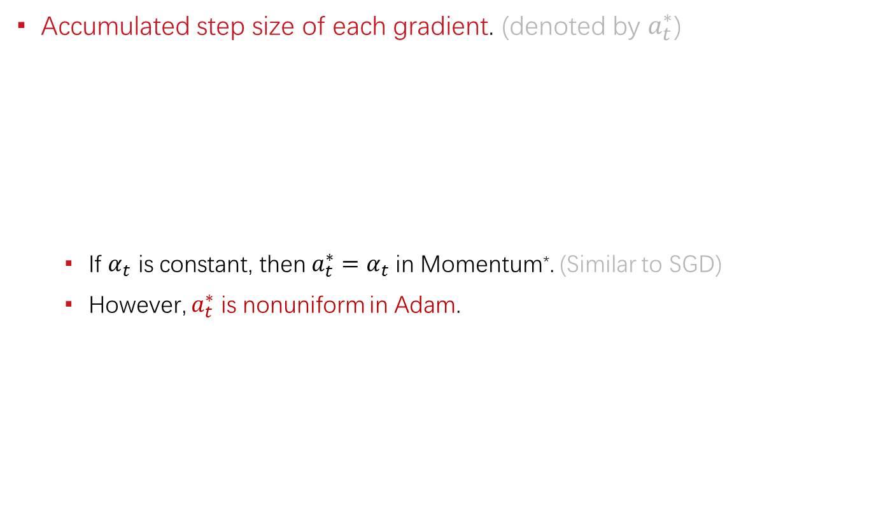

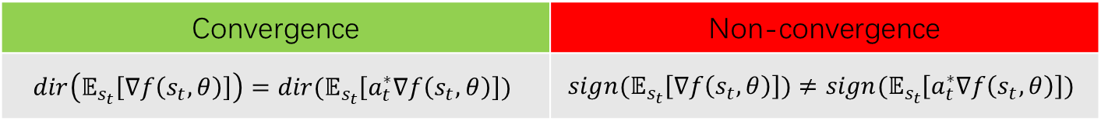
The New Perspective
Accumulated step size of each gradient. (denoted by $a_{t}^{∗}$)
If $α_{t}$ is constant, then $a_{t}^{∗}=α_{t}$ in Momentum*. (Similar to SGD)
However, $a_{t}^{∗}$ is nonuniform in Adam.
 | SGD | Momentum* | Adam
$$a_{t}^{∗}$$ | $$α_{t}$$ | $$\sum_{i=t}^{∞}{α_{i}(1−β_{1})β_{1}^{i−t}}$$ | $$\sum_{i=t}^{∞}{α_{i}\frac{(1−β_{1})β_{1}^{i−t}}{\sqrt{v_{i}}}}$$
Convergence | Non-convergence
$$dir\left(𝔼_{s_{t}}\left[∇f\left(s_{t},θ\right)\right]\right)=dir(𝔼_{s_{t}}\left[a_{t}^{∗}∇f\left(s_{t}, θ\right)\right])$$ | $$sign(𝔼_{s_{t}}\left[∇f\left(s_{t}, θ\right)\right])≠sign(𝔼_{s_{t}}\left[a_{t}^{∗}∇f\left(s_{t}, θ\right)\right])$$
$s_{t}$is sample or mini-batch.

Slide 35
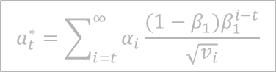


Non-convergence of Adam
Positive correlation between ${{\{v}_{i}\}}_{i=t}^{∞}$ and $g_{t}$:
$v_{t}=β_{2}v_{t−1}+(1−β_{2})g_{t}^{2}$
$v_{t−1}=φ(g_{1},g_{2},g_{3},…,g_{t−1})$ is independent of $g_{t}$.
$v_{t+k}$ is positively correlated with $v_{t}$.
Irregular and biased $a_{t}^{∗}$: (assuming $β_{1}=0$)
$g_{t}$ with large magnitude tends to have a small $a_{t}^{∗}$;
$g_{t}$ with small magnitude tends to have a large $a_{t}^{∗}$.
Counterexamples can hence be easily constructed.
$$a_{t}^{∗}=\frac{g_{t}}{\sqrt{v_{t}}}$$
$$a_{t}^{∗}=\sum_{i=t}^{∞}{α_{i}\frac{(1−β_{1})β_{1}^{i−t}}{\sqrt{v_{i}}}}$$

Slide 36


Towards Convergence
If $v_{t}$ is a random variable independent of $g_{t}$ that follows a fixed distribution,
Then $a_{t}^{∗}$follows a fixed distribution.
Then $dir\left(𝔼_{s_{t}}\left[∇f\left(s_{t}, θ\right)\right]\right)=dir(𝔼_{s_{t}}\left[a_{t}^{∗}∇f\left(s_{t}, θ\right)\right])$ (Similar to SGD)
$$a_{t}^{∗}=\sum_{i=t}^{∞}{α_{i}\frac{(1−β_{1})β_{1}^{i−t}}{\sqrt{v_{i}}}}$$

Slide 37



AdaShift: Core Idea
Calculate $v_{t}$ with temporally shifted $g_{t}$.
Properties:
Independence, if mini-batches (i.e., $s_{t}$) are independent of each other.
Fixed distribution, if $θ_{t}$keeps unchanged. (approximately hold at convergence?)
$$v_{t}=β_{2}v_{t−1}+(1−β_{2})g_{t−1}^{2}$$
$$g_{t}=∇f(s_{t};θ_{t})$$

Slide 38


AdaShift: First Moment
Temporally shift $n$ step and average over the $n$ gradients:
Truncated version of moving average. $β_{1}∈\left[0, 1\right]$.
$$v_{t}=β_{2}v_{t−1}+\left(1−β_{2}\right)g_{t−n}^{2}$$
$$m_{t}={\left(\sum_{i=0}^{n−1}{β_{1}^{i}g_{t−i}}\right)}/{\left(\sum_{i=0}^{n−1}{β_{1}^{i}}\right)}$$

Slide 39






AdaShift: Generalize $v_{t}$
As long as $v_{t}$ is a random variable that is independent of $g_{t}$.
Generalized update rule:
$$v_{t}=β_{2}v_{t−1}+\left(1−β_{2}\right)g_{t−n}^{2}$$
$$φ\left(g_{t−n}\right)=\left\{\begin{matrix}g_{t−n}^{p} & reduce_max (g_{t−n}^{p}) \\ |g_{t−n}| & reduce_mean (g_{t−n}^{p}) \\ norm\left(g_{t−n}\right) & ⋯\end{matrix}\right.$$
$v_{t}=β_{2}v_{t−1}+(1−β_{2})φ(g_{t−n})$
$v_{t}=φ(v_{t−1}, g_{t−n})$
$φ\left(v_{t−1}, g_{t−n}\right)=max \left(β_{2}v_{t−1}, norm\left(g_{t−n}\right)\right)$

Slide 40


AdaShift: Share $v_{t}$ → adaptive SGD
If $φ$ has dimension reduction effect,
Such as norm(), reduce_mean(), reduce_max()
Then, these dimensions will have a shared $v_{t}$.
Then, relative gradient scale among these dimensions will be keep.
Adam | remove gradient scale | Keep the gradient signs.
SGD | keep gradient scale | Keep the gradient direction.
AdaShift | remove the global scale, but keep the relative scale | Keep the gradient direction.

Slide 41
Experiments
Counterexamples: (converge as expected)

Slide 42
Experiments
Benchmarks: competitive with Adam

Slide 43
Experiments
Benchmarks: competitive with Adam

Slide 44

AdaShift++
New feature:
Totally removed the extra memory cost for storing past gradients.
Perfection:
Extensive study of generalized $v_{t}$ and trying to find better variants.
Convergence rate, etc.

Slide 45
Sample Quality Issue
AM-GAN. (ICLR, 2018)

Slide 46
Background
Low sample quality when GANs is trained on complex dataset.
Label information can significantly improve the sample quality.
However,
Existing works lack of theoretical justification.
How class labels interact with GANs is not fully understood.

Slide 47

Limitation of AC-GAN
Adversary training is missing in the auxiliary classifier.
Maximum activation of class logit is not guaranteed to be good sample.
Train an auxiliary classifier.
G maximizes samples’ activation on class logits.
Odena et al. 2017

Slide 48



How LabelGAN Works
Class-aware gradient:
The gradient is distributed to logit $l_{k}\left(x\right)$ according to $\frac{D_{k}(x)}{D_{r}(x)}$.
The gradient tends to refine each sample towards one of the classes.
Salimans et al. 2016

Slide 49

Limitation of LabelGAN
The gradient signal is not clear enough.
It encourages all real classes at the same time.

Slide 50

AM-GAN
Specific target class for each sample. (based on LabelGAN)
Each valid sample must belong to one of the classes.
Clearer gradient information.
Dynamic labeling. (substitute label conditioning, i.e., predefined label)
Generator remains unconditional.

Slide 51
Relationships
Cross entropy decomposition:
AC-GAN = AC + GAN
AM-GAN = AC + LabelGAN

Slide 52
Experiments
(1) AM-GAN outperforms all baselines.
(2) AC-GAN with extra adversarial training outperform AC-GAN.
(3) Dynamic labeling outperforms label conditioning.

Slide 53
AM-GAN Extensions

Slide 54
Understanding Unrestricted GANs
AM-GAN is one of the unrestricted GANs.
A multi-class generalization of vanilla GAN. (with –log D(x) trick)
It does not guarantee its convergence.
The adversarial activation maximization perspective:
In contrast to the divergence perspective.
It helps understand how to make the non-guaranteed training work.

Slide 55
Evaluation Metrics
Inception Score does not work as commonly understood.
Inception Score has some ability to detect mode collapse.
AM-Score proposed to better measure the sample quality.

Slide 56
WGAN / LGANs with labels
WGAN / LGANs have sample level target for each point.
Class label can also be introduced to improve WGAN / LGANs.
Not an extra classifier. (missing of adversarial training)
The correct direction: define class level transport.
It can be achieved with implementation tricks.

Slide 57
Generalization Issue
Work in progress.

Slide 58

Reach the Optimum
Previous effort:
It turns out convolution based D is very hard to achieve the optimum.
Ineffective in representing/expressing $f^{∗}$.
We achieved perfect D and perfect memorization.

Slide 59
Dilemma
Whether we should reach the optimum?
Reach the optimum.
But fail to generalize.
Does not reach the optimum.
Practically, some ability to generalize.

Slide 60
The Ideal Solution
Objective level generalization:
Achieve the optimum.
Modify the objective such that it allows generalization at optimum.
The short-term gain may be negative.
But I believe this is the right direction and something need to be done.

Slide 61
Comparison
Generative model
No generalization at optimum.
The mapping function is fully defined, i.e., all points are mapped to the given dataset.
Discriminative model
Generalization at optimum.
The learned function is only defined at finite points identified by the dataset.
In GANs, new samples will be regards as fake, if the D is powerful enough.

Slide 62
Reference
[1] Zhou, Zhiming, Jiadong Liang, Yuxuan Song, Lantao Yu, Hongwei Wang, Weinan Zhang, Yong Yu, and Zhihua Zhang. "Lipschitz Generative Adversarial Nets." In International Conference on Machine Learning (ICML), 2019.
[2] Zhou, Zhiming*, Qingru Zhang*, Guansong Lu, Hongwei Wang, Weinan Zhang, and Yong Yu. "AdaShift: Decorrelation and Convergence of Adaptive Learning Rate Methods." In International Conference on Learning Representations (ICLR), 2019.
[3] Zhou, Zhiming, Han Cai, Shu Rong, Yuxuan Song, Kan Ren, Weinan Zhang, Jun Wang, and Yong Yu. "Activation Maximization Generative Adversarial Nets." In International Conference on Learning Representations (ICLR), 2018.
https://scholar.google.com/citations?user=b8YJ1EMAAAAJ&hl=en

Slide 63
谢 谢！

Slide 64










From Momentum to Momentum*
Momentum:
Momentum*:
Rewrite $m_{t}^{∗}$and $m_{t}$ in summation of series:
We have that Momentum is equivalent to Momentum* with
$$θ_{ t+1}=θ_{t}−m_{t}^{∗}$$
with
$$m_{t}^{∗}=β_{1}m_{t−1}^{∗}+α^{∗}g_{t}$$
$$θ_{ t+1}=θ_{t}−{αm}_{t}$$
with
$$m_{t}=β_{1}m_{t−1}+(1−β_{1})g_{t}$$
$$m_{t}^{∗}=\sum_{i=1}^{t}{{a^{∗}β}_{1}^{t−i}g_{i}}$$
$$m_{t}=\sum_{i=1}^{t}{{(1−β_{1})β}_{1}^{t−i}g_{i}}$$
$$α=\frac{α^{∗}}{1−β_{1}}$$
$$m_{t}=\frac{1−β_{1}}{α^{∗}}m_{t}^{∗}$$
and
It is worth noticing the change of equivalent learning rate and $α>α^{∗}$.

Slide 65
More
OT-CycleGAN
Large Scale OT with Cycle Extension
Diverse Colorization
Sparse SVBRDF Acquisition

